Slide 1
Data Literacy and Management Basics
Patrick Mathias

Slide 2
https://github.com/pcmathias/MSACL-data-literacy

Slide 3
Disclosure of Relevant Financial Relationships
The faculty, committee members, and staff who are in position to control the content of this activity are required to disclose to MSACL and to learners any financial relationships that have occurred within the last 24 months with ineligible companies whose primary business is producing, marketing, selling, re-selling, or distributing healthcare products used by or on patients. MSACL has reviewed the disclosures and mitigated all relevant financial relationships.
You can view the financial disclosures of any Steering / Scientific Committee Member or Podium Presenters (except for Industry Workshops, which do not qualify for CME credit) on the MSACL website directly underneath the person’s name. Click “Review Relevant Financial Disclosures”.
MSACL staff associated with the development of content for this activity report no relevant financial relationships.
Notes:
This slide must be included in your deck WITHOUT MODIFICATION. You will declare your Relevant Financial Relationships on the following slide.

Slide 4
Relevant Financial Relationships
Company | Relationship | Ended?
None

Slide 5
Lesson Objectives
Describe the different types of analytics (i.e., descriptive, predictive, prescriptive)
Demonstrate how data science can augment expertise to draw robust conclusions and make better decisions
Compare and contrast different data types (e.g., numerical, categorical, timestamp, logical) used in data analytics
Illustrate best practices for organizing data in spreadsheet-based (rectangular) formats for use in data analytics
Identify common problems associated with real world laboratory data (e.g., censoring, keystroke errors, missing values, varied formats) and methods to mitigate them
Perform basic data cleaning and preparation steps to facilitate analysis
Notes:
In this first session our goal is to develop some familiarity with the R programming language.
We will also discuss the important role of reproducible data analysis and how R can help us with this.

Slide 6
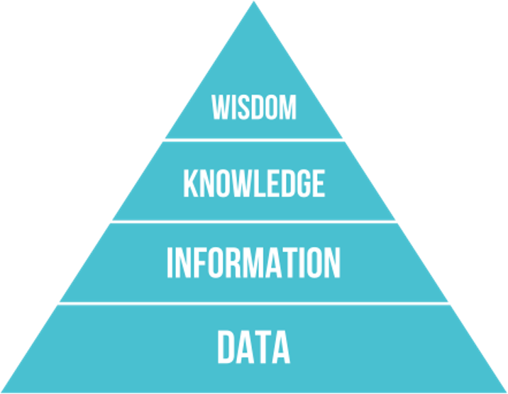
The DIKW Pyramid
Data to be synthesized into knowledge
Knowledge, in turn, can drive decision making

Slide 7
Data Science Background
Notes:
Without further ado, let’s dive in!!
Getting Started with RStudio.

Slide 8
What is data science?
Interdisciplinary field that uses computational methods, statistics, and broad analysis techniques (including visualization) to extract knowledge from data
Draws on a variety of academic disciplines, including mathematics, statistics, computer science, and information science/informatics
Critical to integrate domain knowledge: laboratory medicine

Slide 9
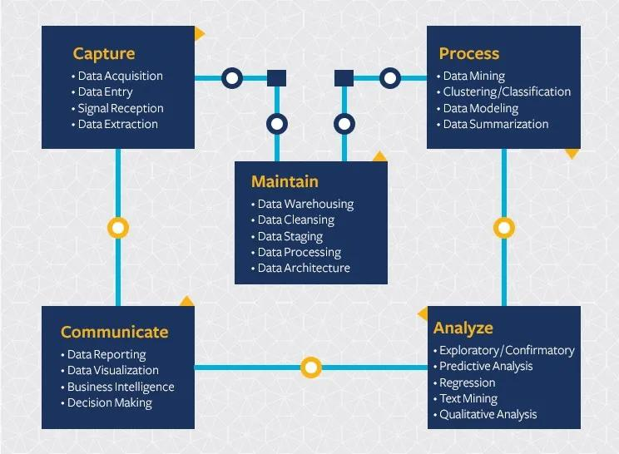
Computational tools support a broad lifecycle to manage a broad range of data
Data science extends beyond analysis of data and includes considerations for capturing and maintaining data
https://ischoolonline.berkeley.edu/data-science/what-is-data-science/

Slide 10
Statistics helps us interpret data based on expectations
Many categories of numeric lab data can be described by known distributions, e.g. normal distribution
Statistical methods allow us to evaluate hypotheses about the data
Does the data fit a normal distribution? If not, why not?
Are the differences between these sets of observations significant?
Notes:
Statistics can also be applied to non-numeric data
E.g. analysis of how words are used in clinical notes and deriving methods to extract useful info

Slide 11
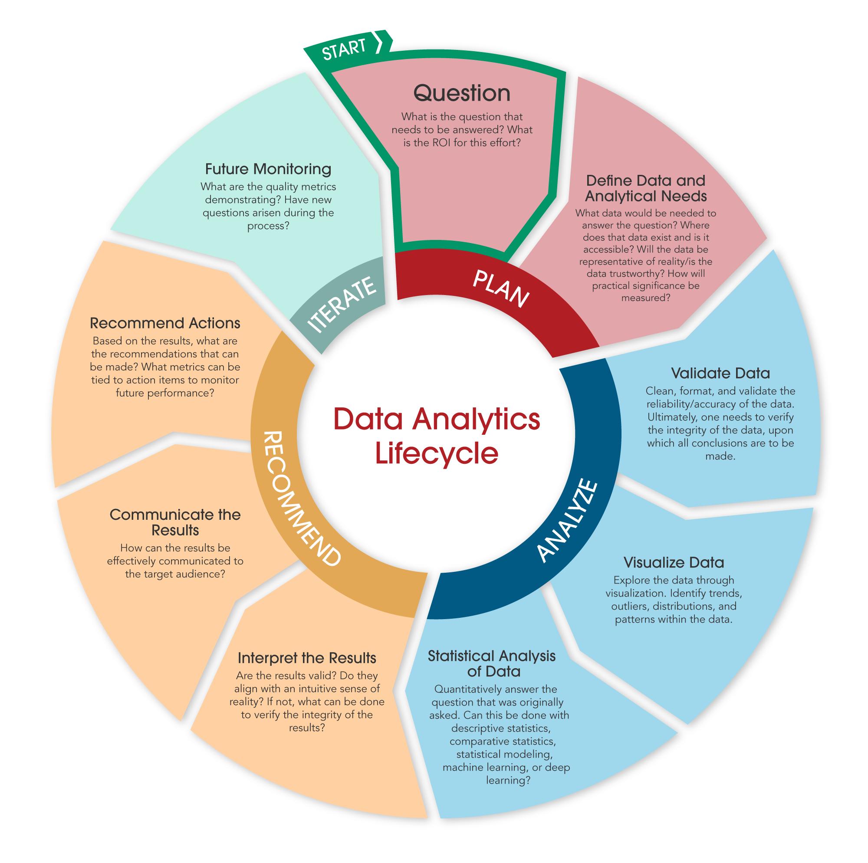
Data Analytics IS a SUBSET of Data Science
Data analytics includes discovering useful information and conclusions to support decision making from data
Using real-world data
Visualization
Statistical and exploratory analysis
Machine learning
Communicating results

Slide 12




Data Science Can be Categorized By How the Data is Applied
Descriptive
Diagnostic
Predictive
Prescriptive
What is happening?
Right now
Recent past
Why is it happening?
What are the root causes?
What will happen?
When might it happen?
What should we do?
Integrate what we think will happen with what has happened

Slide 13
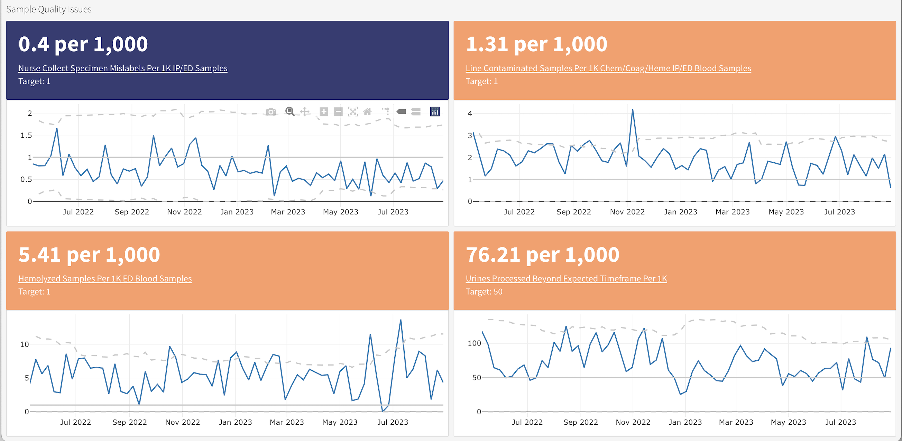
Descriptive Analytics Are Becoming More Common Across Healthcare Settings
DLMP Quality Assurance Dashboard

Slide 14
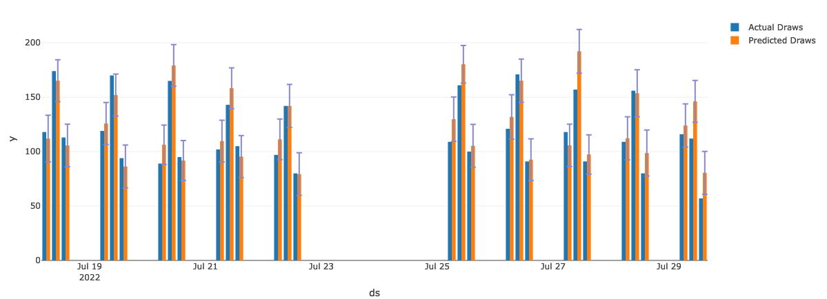
Predictive Analytics Are Emerging In Multiple Domains
UWMC Phlebotomy Prediction

Slide 15
What is the Role of the Laboratorian?
Define the important problems to solve and/or questions to answer
Subject matter expert: those generating the data best understand the data
Perform and interpret routine analyses (e.g. quality control)
Support the validation of analyses done by others
Develop and/or perform new analyses for quality improvement

Slide 16
Where Does Our Data Come From?
Notes:
So now that you've met us let's discuss for a moment how this workshop is going to work

Slide 17

Data in informatics
What is the purpose of data?
Understanding and correct action
Informatics is the study of data
Creation, management, and effective use
Foundational concepts related to data:
Data representation
Data quality
Data flow in an organization from creation to use
© 2023 James H. Harrison, Jr.
Notes:
Informatics can be considered the study of data creation, management, and use in a domain

Slide 18
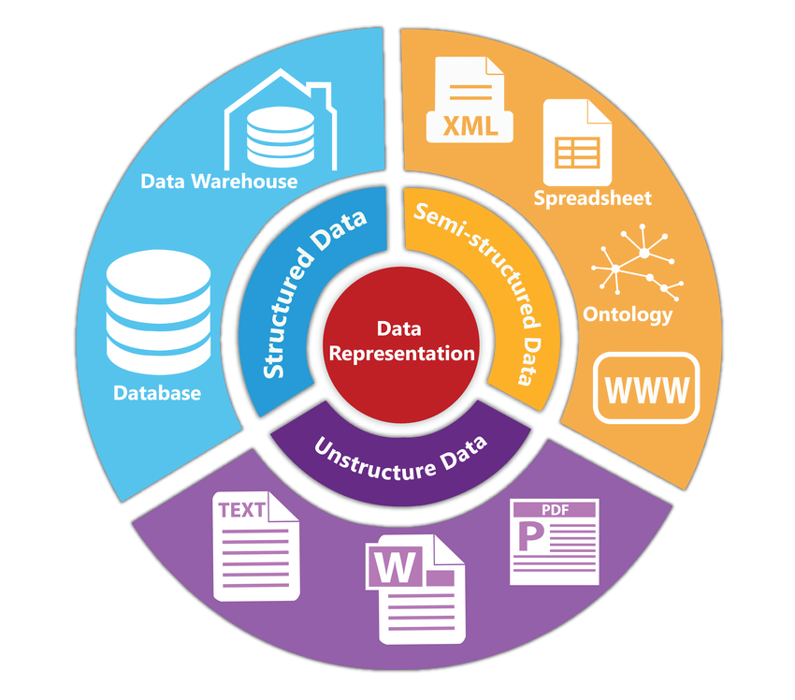
Data representation
Assignment of meaning to physical artifacts
Characters, numbers, words, phrases
Electronic states of computer memory
Human language: Unstructured data
Extremely flexible
Form and usage varies with location and time
Context-dependent
Structured data
Constrained language
Well-defined syntax and semantics
Data standard: Formal agreement on data representation
Siriyasatien et al. IEEE Access 2018.
doi:10.1109/ACCESS.2018.2871241
© 2023 James H. Harrison, Jr.
Notes:
Pre-computer we usually meant visual artifacts
Data standards allow data sharing and interoperability

Slide 19
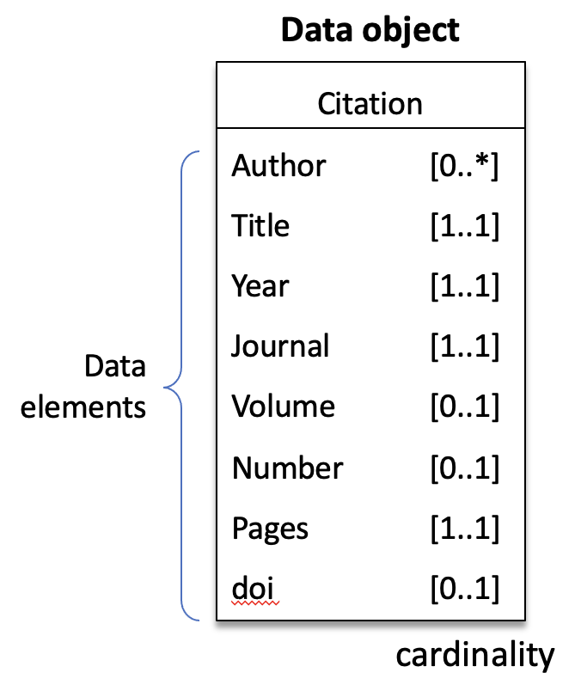
Structured data
Simple data types
Numbers, characters, & character sequences (words, phrases, or codes)
Complex data types
Represent concepts or physical things in the real world
Often called “objects” or “entities”
Built of constituent data types referred to as “data elements” or attributes
Interoperability of data
Portability of data across information systems
Requires common syntax and semantics, or data conversion
© 2023 James H. Harrison, Jr.
Notes:
Data objects have a name and then one or more attributes composed of name-value pairs (the name may be implicit) with the value being a simple or complex data type.

Slide 20
Simple (primitive) data types
Boolean
Two values: pos/neg, T/F, Y/N, 1/0; 1 bit
Integers
Whole numbers, ± ~10 quintillion; 64 bits (8 bytes)
Floating point numbers
Decimal, 15 significant figures; inexact for 1/3, pi, etc.; 64 bits (8 bytes)
Characters
ASCII or Unicode encoded; upper and lower case, numerals, symbols, non-printing characters; represented by numbers using 1 or 2 bytes
Character strings
Sequences of characters with a variable number of bytes based on length
© 2023 James H. Harrison, Jr.

Slide 21

How many ways can “100” be represented in a computer?
Poll

Slide 22
Representation has functional implications
How many ways can “100” be represented in a computer?
All representations are binary
Integer (can’t divide with decimal result or include in text)
Floating point (inexact, can’t include in text)
Character string (can’t do math without conversion)
Medical systems often represent numbers as text.
Space saving with usual sized numbers (less space to store a few chars)
Display as characters is often primary purpose
Math not often needed and can convert when necessary
© 2023 James H. Harrison, Jr.

Slide 23
Beyond Primitive Data Types
Quantitative – data that can be expressed numerically
Continuous – can take any value within a range
Example: 6.022, 3.14, 2.718
Discrete – can only take specific values
Example: 42
Qualitative – descriptive data that represents categories or characteristics
Nominal – categories without a natural order
Example: A, B, O
Ordinal – categories with a natural order
Example: Associates, Bachelors, Masters, Doctorate

Slide 24
We report urinalysis results as 1+, 2+, etc. Which data type are these results?
Poll

Slide 25
How are complex data types constructed?
A defined combination of primitive data types with constraints
Constraints are rules that limit the values of the primitive data types
The components of a complex data type are its data elements
Example: accession number, 22H-034AC01398
Data elements are 3 constrained numbers and 2 constrained character strings
22H-034AC01398
Constraints:
Character length
Numerical value
Set
Two digit
year
Lab
code
Julian
day
Lab
section
Sequential
counter
© 2023 James H. Harrison, Jr.
Notes:
Consider accession number for an example complex data type: 22H-034AC01398 (year, lab, julian day, lab section, sequential counter that resets annually)

Slide 26
Dates and Times Are Important Complex Data Types
Know and love the ISO 8601 standard for representing dates and times
Prevents ambiguity when interpreting and parsing
Dates in filenames sort chronologically
Excel unfortunately does not encourage the use of this format (but can parse it with some extra work)
Obligatory xkcd (https://xkcd.com/1179/)

Slide 27
Vectors & Matrices
Vector = one dimensional collection of homogeneous elements (i.e. everything is the same data type)
Computer keeps track of the order
May perform operations on entire vector or individual elements
[1, 3, 5, 7, 9, 11, 13]
Note: some programming languages refer to the first position as 1 and others refer to it as 0
First position
Seventh position

Slide 28
Vectors & Matrices
Matrix = two dimensional collection of homogeneous data
Row 1, Column 1
1 | 2 | 3 | 4
5 | 6 | 7 | 8
9 | 10 | 11 | 12

Slide 29
Data Frames
Data frame = two-dimensional collection of heterogeneous data
Spreadsheet-like data – typically organized in columns with a fixed data type
Columns (or variables) often explicitly named
Identifier | Location | Test | Value
F123456 | Inpatient | Sodium | 140
W987654 | Outpatient | Potassium | 4.8
X234537 | ED | AST | 70

Slide 30
What is a data model?
A description of the structure of a complex data type
Class diagrams commonly used to depict data models
List of data element (attribute) names, data types, and cardinality
Accession number
Year: string (num)
Lab code: string
Julian day: string (num)
Section code: string
Counter: string (num)
Address
Name: string
Street number: string
Street name: string
Apt number:string
City: string
State: string (codeset)
Zip code: str (num, 5)
Bibliography Entry
Author : string [0..*]
Title : string [1..1]
Year : string [1..1]
Journal : string [1..1]
Volume : string [0..1]
Number : string [0..1]
Pages : string [1..1]
doi : string [0..1]
Cardinality
[Min # .. Max #]
* Any number
[0..1] optional
[1..1] required
© 2023 James H. Harrison, Jr.

Slide 31
How do computers store data?
Data in working memory is volatile
Lost if powered down
Non-volatile media (disks, tape, solid state storage, optical)
Maintains state without power
Data can be preserved by copying it to non-volatile media in files
Files are a block of binary data with a known size and position in the media
Files have names, creation dates, and modification dates
Filename extensions may indicate the type of file or creating program
Internal structure allows data to be accurately recognized
File structure may be proprietary or an open standard
© 2023 James H. Harrison, Jr.

Slide 32
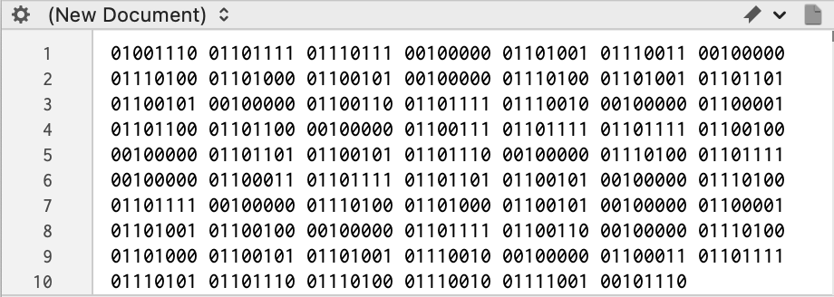
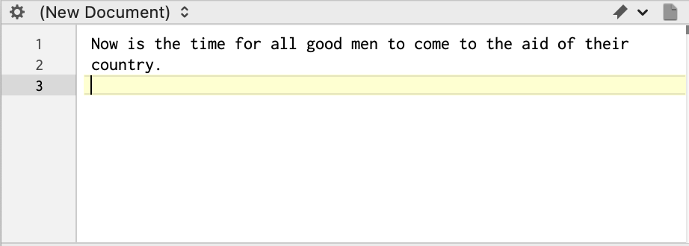
Storing data in files
Binary files
Binary encoding, meaning is software-specific and defined by the software authors
Native Word, Powerpoint, and Excel files
Text files
Store data as characters, including numbers
Plain text (“flat file” or unstructured text, a character string in Unicode or ASCII)
Rich text format (RTF), character sequences indicate formatting
Delimited files
Comma separated values (CSV), quoted CSV, tab delimited, space delimited
Structured text (eg, json or xml)
Databases
Files specially structured for rapid and reliable data storage, update, search, and retrieval
ASCII-encoded text
© 2023 James H. Harrison, Jr.

Slide 33
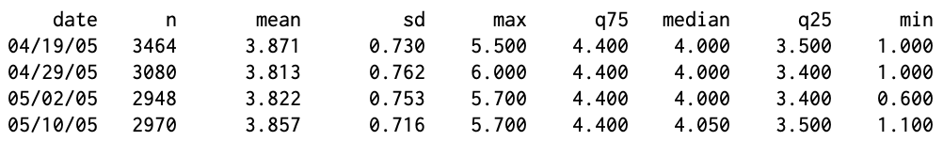
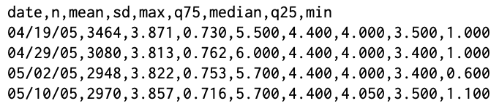
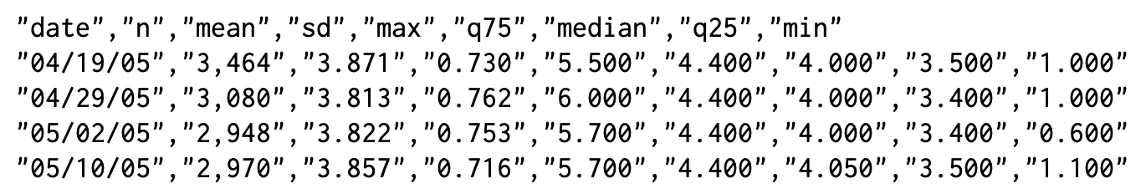
Delimited files
Comma separated values (CSV)
Quoted CSV
© 2023 James H. Harrison, Jr.

Slide 34
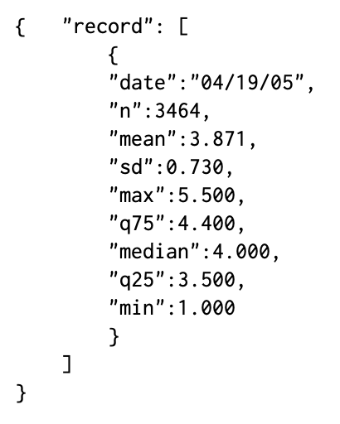
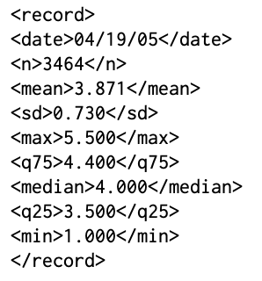
Structured text
Javascript Object Notation (JSON)
Extensible Markup Language (XML)
Tags “contain” values
Opening and closing tags
Nested tags
Larger files but most flexible
Attribute-value pairs
Requires attribute names for all values
© 2023 James H. Harrison, Jr.
Notes:
The CSV file is maintained at the top for comparison. A data standard defines the structure of complex data elements in a domain, including the delimiting scheme, names or codes for the attributes (data elements) with definitions, and standard constraints for attribute content with definitions of content meaning.

Slide 35
Exercise 1
Find the lesson_1_exercises.pdf file in the exercises folder of your project folder (that you downloaded at the start of the lesson).
Open the pdf and follow the instructions for Exercise 1

Slide 36
Data quality
Completeness | Is data present and available?
Correctness | Is data true?
Concordance | Is there agreement and consistency between data elements?
Plausibility | Does data make sense in the clinical context?
Currency | Is data a relevant representation at a defined point in time?
Weiskopf NG, Weng C. Methods and dimensions of electronic health record data quality assessment: enabling reuse for clinical research. J Am Med Inform Assoc. 2013;20(1):144-151. doi:10.1136/amiajnl-2011-000681
© 2023 James H. Harrison, Jr.
Notes:
Why is data quality important for computers? Humans become conservative when data is uncertain and the stakes are high computers don’t unless programmed in, handling uncertainty, incorporating low quality into result (result quality may reflect lowest quality data), garbage in & garbage out

Slide 37
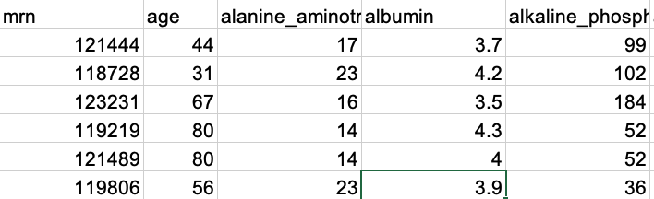
Ideal World Data
Data Completeness
Clinical, Laboratory, Billing, and Logistics data all in one place
Data Structure
Discrete
Standardized
Tabular
Data Timeliness
Access to what you need within hours to days
Ideal

Slide 38
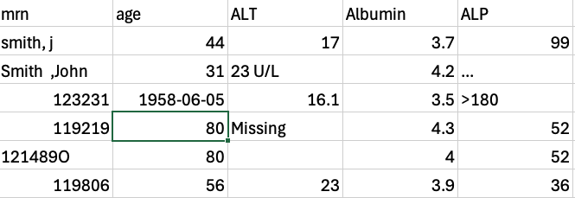
Real World
Data Completeness
Fragmented
Multiple computer systems are often used depending on the need
Data Structure
Some discrete and tabular
Free text common as well
Miscellaneous tests, comments, interpretations, clinical notes……….
Data Timeliness
Stretched for dedicated health information technology resources
Large amounts of data can be often difficult to access
Reality

Slide 39

Common Sources of Errors
Manual processes
Result entry
Process errors
Analytical Errors
Systemic Reporting Errors
Incorrect formatting from laboratory information system

Slide 40
Other “Issues” With Data
Many other data best practices are discouraged because they can cause difficulties or errors within the data set:
Naming inconsistencies
Merging data from multiple sites with different names can cause errors
Strange formats
Inclusion of spaces, mixed cases, and special characters can all make your data “disappear” when reading it into or formatting within statistical software
Inconsistencies with data entry
Manual entry can lead to errors in data aggregation when not carefully controlled

Slide 41
Reporting Inconsistencies
Laboratory tests have local differences in how they are named and reported
These differences must be considered when constructing your dataset
Examples include:
Different units → T3 commonly reported as either ng/ml and ng/dl
Different names → Urine albumin vs. Microalbumin
Different metadata → Potassium specimen type combined vs. not combined

Slide 42
What errors have you seen in your data?
Poll

Slide 43
EHR data quality
Type of data | Relative quality | Comments
Demographics | Relatively high | Patients alive are overestimated because of limited processes to update patients’ statuses unless they expire in the hospital
Lab results | Very high | Dependent on clinical ordering; testing at different locations may not be shared; absent results are not the same as negative results
Medication orders | Very high | Prescriptions written may not be filled or taken
Vital signs | High | Data collected for immediate clinical need
Test orders | High | Reflect immediate clinical need, may not be shared across locations
Diagnoses | Medium | Variable, may be missing or may represent possibilities
Family & past hx. | Low | Often missing, better if standardized collection of specific elements
Other incl. notes | Variable | Depends on data element and incentive for accurate collection
Sutherland SM, et al. Electronic Health Record-enabled research in children using the Electronic Health Record for clinical discovery. Pediatr Clin North Am. 2016;63(2):251-268. doi:10.1016/j.pcl.2015.12.002
© 2023 James H. Harrison, Jr.
Notes:
Quality varies across data elements. Part of the reason is that data is entered by a variety of people with different levels of training and data entry support (error checking). Note “copy paste” issues with relatively static information may lead to omission of elements or failure to include new elements.

Slide 44






Data flow in summary: Creation to action
Sources
Storage/management
EHR databases
Data warehouses
Use
Capture, communication, and mapping
Analytics and reporting
Information systems
Data organization
Preservation & access
Cleaning and consistency checking
Presentation
Interpretation
Understanding
Effective action
Variable representation and quality
© 2023 James H. Harrison, Jr.
Notes:
Goal is evidence-based action; laboratory information stewardship encompasses this entire process as it relates to lab data

Slide 45
Principles of TIDY Data
Notes:
So now that you've met us let's discuss for a moment how this workshop is going to work

Slide 46
Databases: Data storage plus
A file or files of related data elements structured for rapid and reliable data storage update, search, and retrieval
Database management system (DBMS)
Collection of programs that allows multiple users to create, maintain, and use databases
Controls user access to the data
Indexes and sorts data to allow rapid numerical and text query
May provide error checking and other data integrity features
May allow databases that are larger than RAM
© 2023 James H. Harrison, Jr.

Slide 47

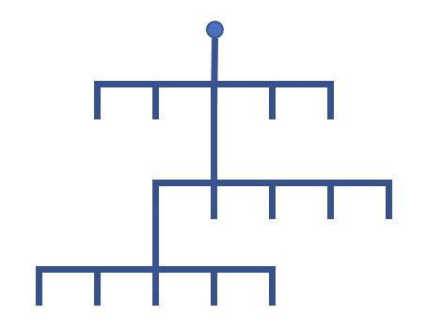
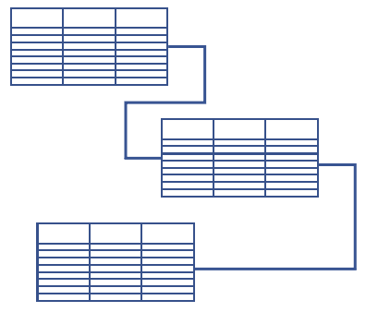
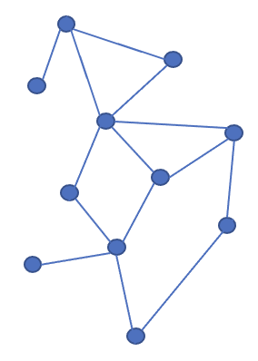
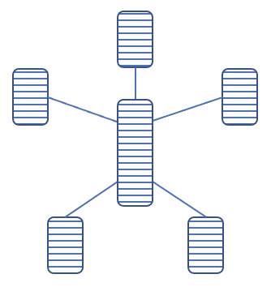
Types of databases (by data organization)
Flat file
Simple: single table, rows (records) and columns (fields)
Rigid structure, redundant data, slow with large data volume
Hierarchical
Relational
Other
Analytic databases
© 2023 James H. Harrison, Jr.

Slide 48


Why have different kinds of databases?
Represent relationships in data; avoid wasted space and redundancy
1 to 1
1 to many
many to many
Patient
Patient
Patients
PCP
Test results
Physicians
Flat file
Hierarchical
Relational
Flat file
Hierarchical
Relational
Flat file
Hierarchical
Relational
© 2023 James H. Harrison, Jr.
Notes:
Optional slide, for more detail

Slide 49
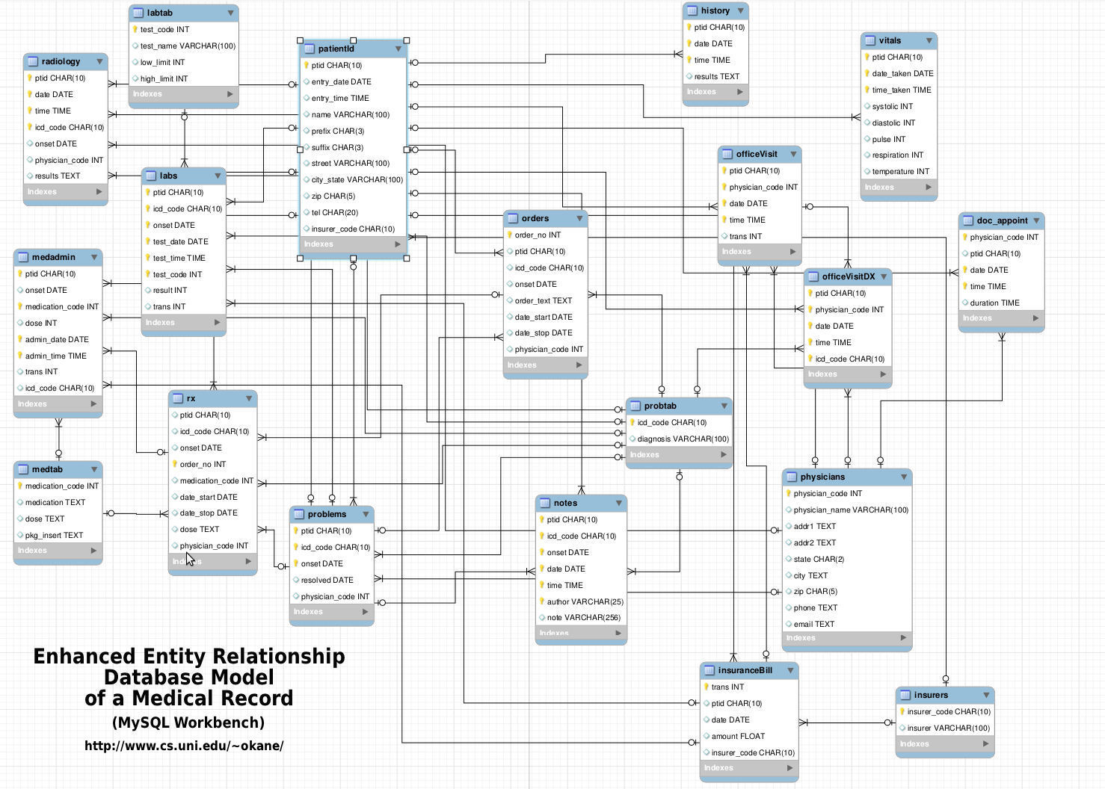
Relational databases
Codd’s rules (1985)
Multiple linked tables
Tables represent “entities”
Links are relationships
Flexible cardinality
Slower updating and retrieval than hierarchical*
Multiple query paths with decent performance
Transactional/rollback (“ACID”)
SQL query language
Epic Clarity, Cerner, CoPath APLIS
Labs
© 2023 James H. Harrison, Jr.
Notes:
RDB defined by EF Codd in 1985 (Codd’s 12 rules, actually 13 because they’re numbered 0 to 12); the point is that RDB are formally defined and well understood, not to know the individual rules.
Moves elements that would be redundant in flat files into separate linked tables
Fields are columns in the tables, records are rows in the tables
Slower than hierarchical in queries along the hierarchical branches. Much faster for queries across the branches (ie all patients with lab tests of a particular type that have values in a particular range)
Features of transactions: ACID = Atomic, Consistent (correct), isolated (independent), durable

Slide 50
RDB keys, relations, and cardinality
PK
PK
Shared keys define links between tables (relations)
Primary key (PK)
Foreign key (FK)
Matching on shared data
Cardinality
1 to many (*)
Many to 1
Many to many
1 to 1 (not shown)
Optionality (0..)
PATIENT
PHYSICIANS
Pat_ID MRN Name…
Phys_ID Name Specialty…
•
•
•
•
•
•
1
1
PK
FK
FK
ENCOUNTERS
Enc_ID Date Pat_ID Phys_ID…
•
•
•
0..*
0..*
© 2023 James H. Harrison, Jr.
Notes:
Optional slide for more detail
Many to many reduces redundancy (takes care of repeated physicians from pure hierarchicial DB)
Importance of data integrity and not orphaning data
May delete to save time.

Slide 51
Describing RDB structure and contents
Schema: table structure with relations and required data types
Entity-relationship (ER) diagram
Normalized schema (“normal form”)
Optimum structure without inappropriate data dependencies or redundancy
Relaxed in practice for speed
Data dictionary: list of data elements (column names)
© 2023 James H. Harrison, Jr.
Notes:
Multiple levels of normal form, relaxation of normalization is a judgement call per database

Slide 52
RDB Query: Structured Query Language (SQL)
Standard (sort of) query language for all relational databases
Statements for creating, managing, updating, querying, deleting records
Query statement:
…returns a single table of matching data elements
JOIN tables using matching key values to query multiple tables
SELECT <column names>
FROM <table> JOIN <table> ON <column>
WHERE <query parameters>
ORDER BY <sorting parameters>
SELECT <column names>
FROM <table>
WHERE <query parameters>
ORDER BY <sorting parameters>
© 2023 James H. Harrison, Jr.
Notes:
Optional slide for more detail

Slide 53
Relational databases May Utilize a “Tidy” Representation of Data
Patient ID | MRN | First Name | Last Name | Order ID | Order Code | Order Name | Accession | Tube
23 | 123456 | John | Smith | 101 | CBC | Complete Blood Count | 5679 | LAV
23 | 123456 | John | Smith | 102 | BMP | Basic Metabolic Panel | 5680 | GRN
24 | 098765 | Jane | Doe | 103 | BLDCLT | Blood Culture | 5733 | BLD
24 | 098765 | Jane | Doe | 104 | HPTSWKUP | Hepatitis Workup | 5734 | GLD
24 | 098765 | Jane | Doe | 104 | HPTSWKUP | Hepatitis Workup | 5735 | PRL
24 | 098765 | Jane | Doe | 105 | CRP | C Reactive Protein | 5812 | GRN
PatientID | MRN | FirstName | LastName
23 | 123456 | John | Smith
24 | 098765 | Jane | Doe
PatientID | OrderID | OrderCode | OrderName
23 | 101 | CBC | Complete Blood Count
23 | 102 | BMP | Basic Metabolic Panel
24 | 103 | BLDCLT | Blood Culture
24 | 104 | HPTSWKUP | Hepatitis Workup
24 | 105 | CRP | C Reactive Protein
OrderID | Accession | Tube
101 | 5679 | LAV
102 | 5680 | GRN
103 | 5733 | BLD
104 | 5734 | GLD
104 | 5735 | PRL
105 | 5812 | GRN
Notes:
One challenge in dealing with common extraction tools regardless of the system is the need to pull additional data – whether that is a larger data set than your utility can handle or a larger number of data elements than is available
It is important to recognize the value of speaking a relational database’s language and the flexibility that affords for extracting data
As a concrete example you may want to analyze some data that combined patient demographics, order details, and tube type
Each of these data elements may be stored in its own table within a database and based on your knowledge of the system and workflows you can connect the right data elements using a series of keys that establish the relationships between tables

Slide 54
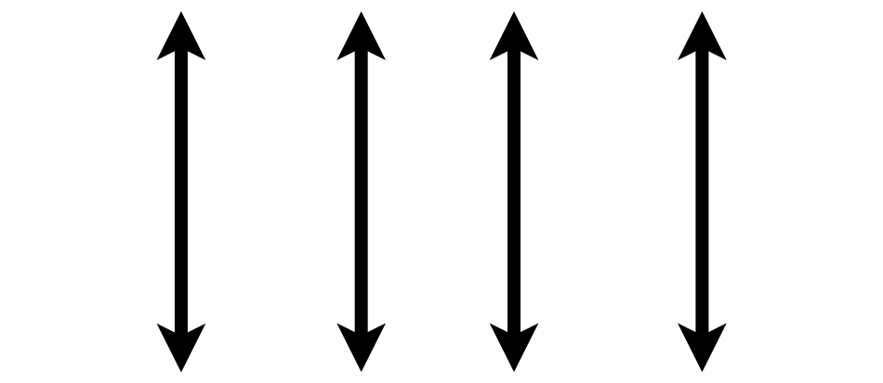

Tidy Data Summarized
A data set is tidy if:
Each variable is in its own column
Each observation is in its own row
Each value is in its own cell
MRN
Wickham, H. . (2014). Tidy Data. Journal of Statistical Software, 59(10), 1–23.

Slide 55
Consider a single data set with 4 variables
country
year
population
cases
Public health data set intended to represent the cases of a disease in a population by country and year

Slide 56
Representation 1
## # A tibble: 12 x 4 ## country year type count ## <chr> <int> <chr> <int> ## 1 Afghanistan 1999 cases 745 ## 2 Afghanistan 1999 population 19987071 ## 3 Afghanistan 2000 cases 2666 ## 4 Afghanistan 2000 population 20595360 ## 5 Brazil 1999 cases 37737 ## 6 Brazil 1999 population 172006362 ## 7 Brazil 2000 cases 80488 ## 8 Brazil 2000 population 174504898 ## 9 China 1999 cases 212258 ## 10 China 1999 population 1272915272 ## 11 China 2000 cases 213766 ## 12 China 2000 population 1280428583

Slide 57
Representation 2
## # A tibble: 6 x 3 ## country year rate ## * <chr> <int> <chr> ## 1 Afghanistan 1999 745/19987071 ## 2 Afghanistan 2000 2666/20595360 ## 3 Brazil 1999 37737/172006362 ## 4 Brazil 2000 80488/174504898 ## 5 China 1999 212258/1272915272 ## 6 China 2000 213766/1280428583

Slide 58
Representation 3 is Tidy
## # A tibble: 6 x 4 ## country year cases population ## <chr> <int> <int> <int> ## 1 Afghanistan 1999 745 19987071 ## 2 Afghanistan 2000 2666 20595360 ## 3 Brazil 1999 37737 172006362 ## 4 Brazil 2000 80488 174504898 ## 5 China 1999 212258 1272915272 ## 6 China 2000 213766 1280428583

Slide 59
Why keep things tidy?
Consistent mental model for data = common data manipulation becomes easier
Many tools in R (and Excel + other languages) make it very easy to do sophisticated analysis and visualization with tidy data
Databases that store data from clinical information systems often already represent data in a tidy form

Slide 60
Tidy Data Summarized
A data set is tidy if:
Each variable is in its own column
Each observation is in its own row
Each value is in its own cell
MRN
Wickham, H. . (2014). Tidy Data. Journal of Statistical Software, 59(10), 1–23.

Slide 61
Exercise 2
In the lesson_1_exercises pdf follow the instructions for Exercise 2

Slide 62
Tips for Generating Your Own Data

Slide 63
Building your own data set
Data analysis projects beyond a certain complexity require creating your own variables or data frames (tables/spreadsheets)
In addition to building tidy data sets, consider steps to make future analysis easier

Slide 64
Naming Variables
Use variable (column) names that are easy for someone not performing your analysis to understand
“result_value” as opposed to “x”
“collection_time” instead of “time”
Stick to naming that will make it easier for a computer to read the data
Avoid spaces in names: “result_value” instead of “result value” (space has meaning in languages like R)
All lowercase (or uppercase) will be easier for you to type, even if it is not easier for the computer to parse

Slide 65
Respect Data Types When Creating Variables
Variable inspection and summarization is much easier (and less error prone) if known data types are used
run_id | value
1 | 5
2 | cancelled
3 | 11
4 | < 2
5 | 4
run_id | value | comment
1 | 5
2 |  | cancelled
3 | 11
4 |  | < 2
5 | 4

Slide 66
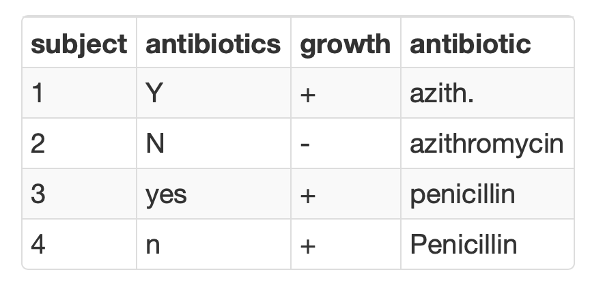
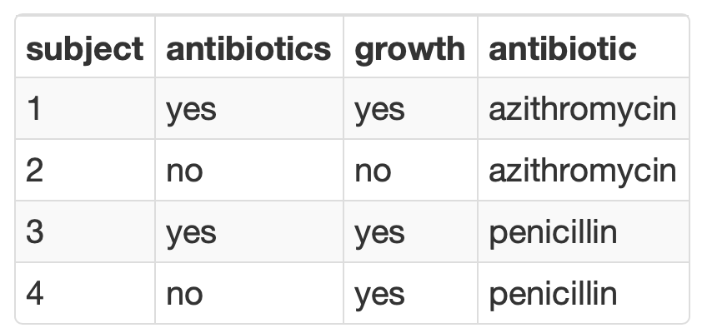
Consistency is Critical for Analyzing Categorical Variables
Summarization is seamless when consistent values are used to represent binary or categorical variables

Slide 67
Thinking Like a Computer
Notes:
So now that you've met us let's discuss for a moment how this workshop is going to work

Slide 68
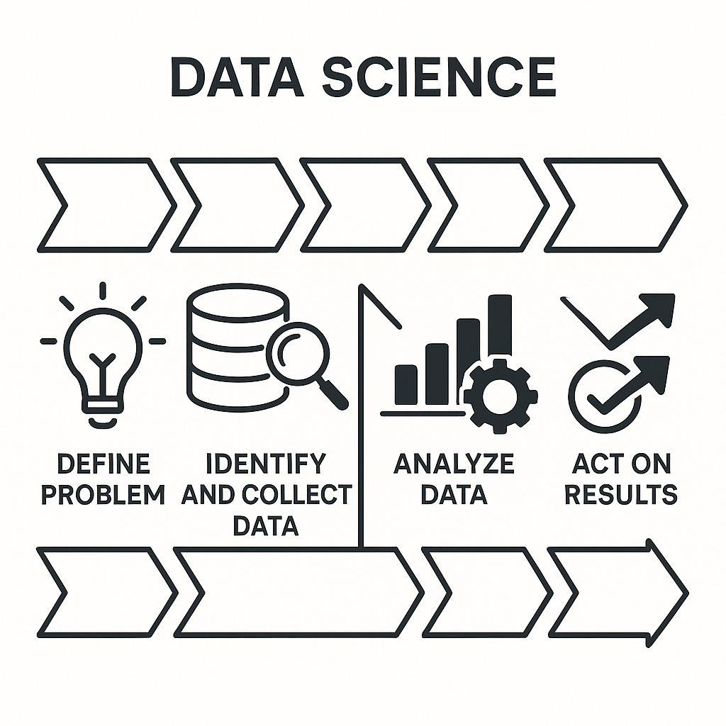
Computational Thinking
Breaking a “real world” problem down into a computational framework
Define problem
Identify and collect data
Design experiment or data analysis
Analyze data
Interpret and present data
Act on results

Slide 69
What’s your problem? Laboratory quality
Clinicians at one of your academic health system’s sites are reporting a positivity rate for norovirus that is higher than expected from your gastrointestinal pathogen molecular testing panel.
Notes:
Where do you start?
What data sources may be helpful to understand the potential problem?
How do you use data to understand the impact of the potential problem and decide on next steps?

Slide 70




What’s your problem? Laboratory quality
Request or extract result data
Determine positivity rate by location
Interface with clinical teams on expected rates
Engage vendor
Notes:
Where do you start?
What data sources may be helpful to understand the potential problem?
How do you use data to understand the impact of the potential problem and decide on next steps?

Slide 71
What’s your problem? Process improvement
Turnaround times for your batched toxicology testing are higher than your goals. You suspect there may be a mismatch between when samples are received into the lab and when you have scheduled your runs.

Slide 72




What’s your problem? Process improvement
Request or extract receipt timestamps and turnaround times
Visualize turnaround times and volumes by receipt time
Correlate with run schedules
Update schedules as needed

Slide 73
What’s your problem? Risk prediction
Your hospital is not meeting its goals for performing appropriate lactate testing as well as other interventions (e.g. fluid resuscitation) in patients who are diagnosed with sepsis during their stay. Care teams want to increase appropriate testing but do not want to over-order tests in patients who have a low likelihood of being diagnosed with sepsis.

Slide 74




What’s your problem? Risk prediction
Review literature and vendor materials for existing sepsis prediction models
Assess performance of model(s) using existing retrospective data
Implement model meeting defined performance characteristics
Continuously monitor model and ensure appropriate performance

Slide 75
What’s your problem? Diagnosis
Your laboratory has identified that some patients with complex toxicology tests are being misdiagnosed because some care providers do not understand the data from confirmatory mass spectrometry tests. Your toxicologists provide interpretive comments to assist those clinicians but it is challenging to keep up with the growth in testing.

Slide 76



What’s your problem? Diagnosis
Assemble large retrospective data set containing analyte data and interpretations
Develop candidate models using testing & training splits
Assess performance in prospective data set
Continuously monitor model and ensure appropriate performance

Slide 77
Lesson Objectives
Describe the different types of analytics (i.e., descriptive, predictive, prescriptive)
Demonstrate how data science can augment expertise to draw robust conclusions and make better decisions
Compare and contrast different data types (e.g., numerical, categorical, timestamp, logical) used in data analytics
Illustrate best practices for organizing data in spreadsheet-based (rectangular) formats for use in data analytics
Identify common problems associated with real world laboratory data (e.g., censoring, keystroke errors, missing values, varied formats) and methods to mitigate them
Perform basic data cleaning and preparation steps to facilitate analysis
Notes:
In this first session our goal is to develop some familiarity with the R programming language.
We will also discuss the important role of reproducible data analysis and how R can help us with this.

Slide 78
References & Acknowledgements
James Harrison, Introduction to Pathology Informatics, Session 8: Cybersecurity, API Distribution 1.0, 2023. Available at: https://www.pathologyinformatics.org/teaching-slide-sets
Robert Benirschke & Chris McCudden for slides adapted from ADLM Data Science Certificate

